Slide 1

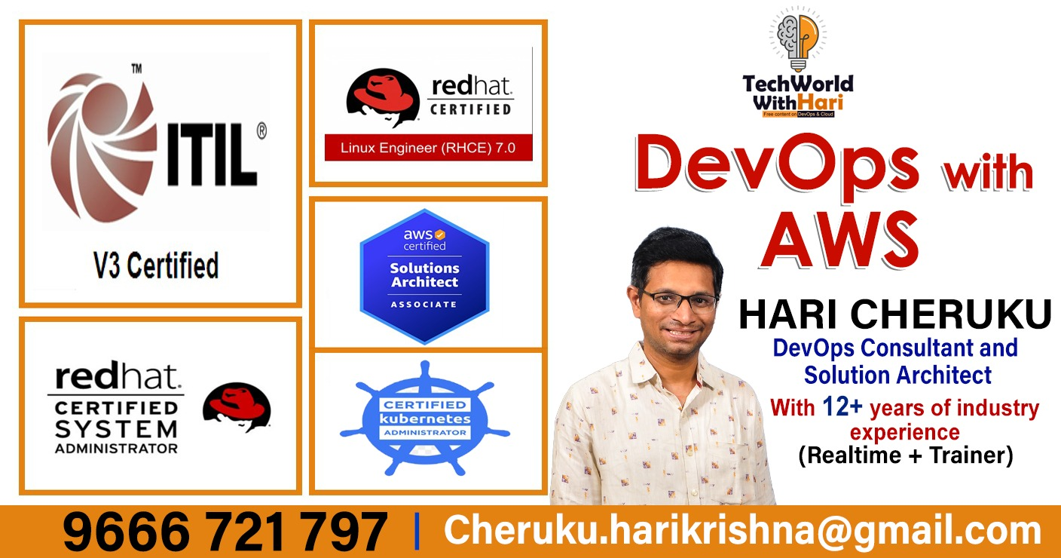


Slide 2

1) What Exactly is Cloud?
What are The Beneﬁts of Cloud?
Why need to Learn Cloud?
What Cloud Options We have ?
What Skills Needed to be Cloud Job Ready?
What is Cloud?
Youtube channel : techworldwithhari

Slide 3
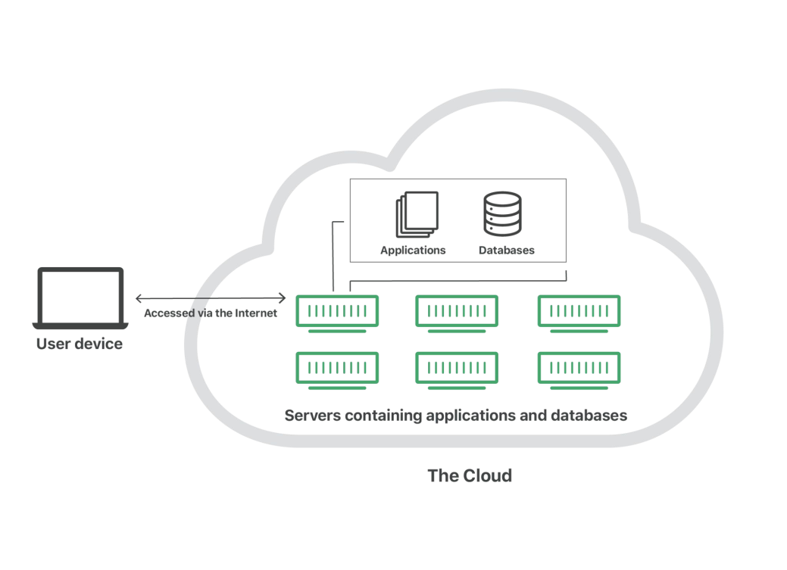
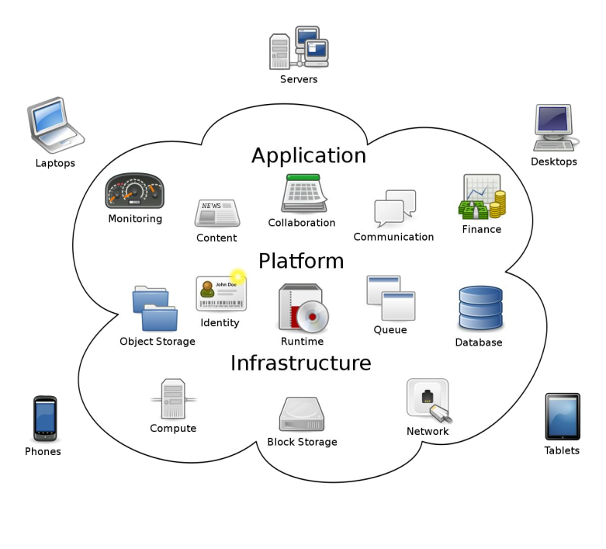
What is Cloud?
Cloud computing is the on-demand delivery of IT resources over the Internet with pay-as-you-go pricing. Instead of buying, owning, and maintaining physical data centers and servers, you can access technology services, such as computing power, storage, and databases, on an as-needed basis from a cloud provider such as Amazon Web Services (AWS), Microsoft Azure ,Google Cloud Platform(GCP)

Slide 4
What are The Beneﬁts of The Cloud?
.
Cost Saving
The services are free from capital expenditure.
Rather than purchasing expensive systems and equipment for your business, you can reduce your costs by using the resources of your cloud computing service provider, you just have to pay as you operate it and enjoy the model based on your subscription plan.
24 X 7 Availability
Most of the cloud providers are truly reliable in offering their services, with most of them maintaining an uptime of 99.9%. The workers can get onto the applications needed basically from anywhere. Some of the applications even function off-line.
Scalability
It offers ﬂexible facility which could be turned off, up or down as per the circumstances of the user. For instance, a promotion of sales is very popular, capacity can be immediately and quickly added to it for the avoidance of losing sales and crashing servers. When those sales are done, the capacity can also be shrunk for the reduction of costs.
All over Functioning Cloud computing offers yet another advantage of working
from anywhere across the globe, as long as you have an internet connection. Even while using the critical cloud services that offer mobile apps, there is no limitation of the device used.
Security
Cloud computing offers great security when any sensitive data has been lost. As the data is stored in the system, it can be easily accessed even if something happens to your computer. You can even remotely wipe out data from the lost machines for avoiding it getting in the wrong hands.
Automated Updates on Software In cloud computing, the server suppliers regularly update your software including the updates on security, so that you do not need to agonize on wasting your crucial time on maintaining the system. You find extra time to focus on the important things like ‘How to grow your businesses.
Easily Manageable
Cloud computing offers simplified and enhanced IT maintenance and management capacities by agreements backed by SLA, central resource administration and managed infrastructure. You get to enjoy a basic user interface without any requirement for installation. Plus you are assured guaranteed and timely management, maintenance, and delivery of the IT services.
Enhanced Collaboration Cloud applications enhance collaboration by authorizing diverse groups of people virtually meet and exchange information with the help of shared storage. Such capability helps in improving the customer service and product development and also reducing the marketing time.
Reduced Carbon Footprint/Sustainable
Disaster Recovery
The biggest disaster a company can undergo is "loss of data." However, the cloud is a repository for backed up data, which helps companies recover their lost data with ease and security.
Cloud computing is helping out organizations to reduce their carbon footprint. Organizations utilize only the amount of resources they need, which helps them to avoid any
over-provisioning. Hence, no waste of resources and thus energy.

Slide 5
Why Need To Learn Cloud?
High Demand : All Industries embracing cloud, moving from on-premise to Public Cloud, to save cost, which is creating demand for Cloud Engineers hence more opportunities.
Future Proof Career: Cloud Computing is demand from last many years and in future also going to stay and even grow further, which simply create more opportunities for Cloud Architects / Engineers / Application Developers
Increase Your Professional Profile: If you learn Basics of Cloud, then you can transfer your current skills set to Automation, Development, Networking in the cloud, it will definitely increase your professional profile. Additionally if managed to keep learning , keep achieving new skills and gain Cloud Certifications, then it will be more AWESOME!
Personal growth and future Scope: The purpose of Learning Cloud is not just about getting job in a company, if you become skilled enough, you can start your start up company, or you can offer Cloud COnsulting Services, or just as a hobbing solve traditional problems with Cloud Skills, not just that, the skills you gain through Cloud learning Journey you can use it as you see fit, upto your creativity!
High Earning: When the demand of Cloud Professionals is high then the current available talents, you have potential to gain high earning.

Slide 6
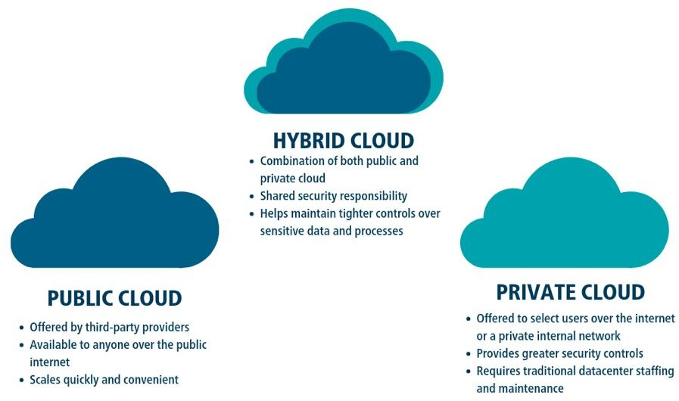
What Cloud Options We have ?
.
Types Of Cloud Based on Usage
Cloud computing is available in three types of usage. They are public, private, and hybrid clouds. Public cloud and private cloud are two terminologies commonly used in the market today. Let’s see what do they mean and the difference between public cloud and private cloud.
Public Cloud
Private Cloud
Hybrid Cloud
This is a publicly accessible framework where one can store data or use it as a virtual machine. This can be done either by programming or autonomously. Here individual does not have to invest time and effort in buying physical servers but can get started in no time. Public clouds are available to use on pay per approach basis.
If one needs to have a cloud exclusively for the organization then a private cloud is the best option. Along with the ﬂexibility it provides one can opt for a data center on the premises for security and compliance needs. A dedicated professional is required to manage the private cloud framework.
Hybrid is a combination of public and private clouds. For certain business needs who can beneﬁt from the combination are the ones who use a hybrid cloud.

Slide 7
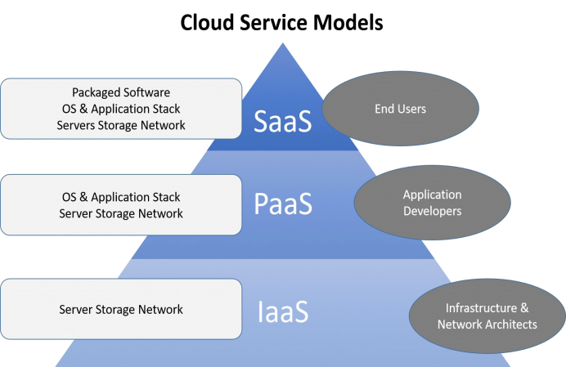
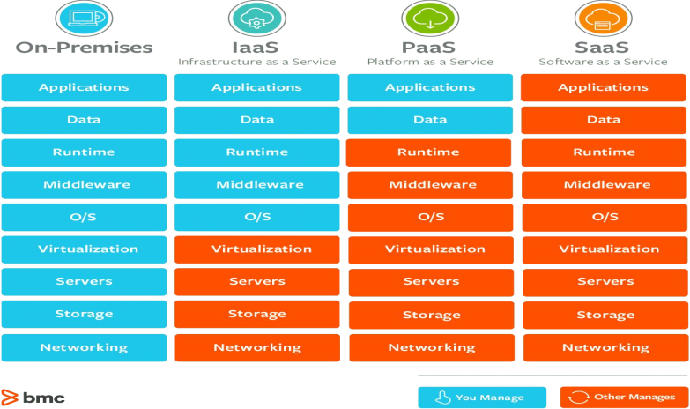
What Cloud Options We have ?
.
Types of Cloud Computing
The three main types of cloud computing include Infrastructure as a Service, Platform as a Service, and Software as a Service. Each type of cloud computing provides different levels of control, flexibility, and management so that you can select the right set of services for your needs.
Infrastructure as a Service (IaaS)
IaaS contains the basic building blocks for cloud IT. It typically provides access to networking features, computers (virtual or on dedicated hardware), and data storage space. IaaS gives you the highest level of flexibility and management control over your IT resources. It is most similar to the existing IT resources with which many IT departments and developers are familiar.
Platform as a Service (PaaS)
Software as a Service (SaaS)
PaaS removes the need for you to manage underlying infrastructure (usually hardware and operating systems), and allows you to focus on the deployment and management of your applications. This helps you be more efﬁcient as you don’t need to worry about resource procurement, capacity planning, software maintenance, patching, or any of the other undifferentiated heavy lifting involved in running your application.
SaaS provides you with a complete product that is run and managed by the service provider. In most cases, people referring to SaaS are referring to
end-user applications (such as
web-based email). With a SaaS offering, you don’t have to think about how the service is maintained or how the underlying infrastructure is managed. You only need to think about how you will use that particular software.

Slide 8

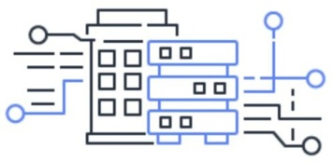
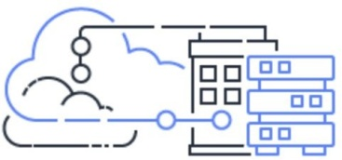
What Cloud Options We have ?
.
Cloud Computing Deployment Models
Below are 3 Cloud Computing Deployment Models
Cloud
A cloud-based application is fully deployed in the cloud and all parts of the application run in the cloud. Applications in the cloud have either been created in the cloud or have been migrated from an existing infrastructure to take advantage of the benefits of cloud computing. Cloud-based applications can be built on low-level infrastructure pieces or can use higher level services that provide abstraction from the management, architecting, and scaling requirements of core infrastructure.
On-premises
Hybrid
Deploying resources on-premises, using virtualization and resource management tools, is sometimes called “private cloud”. On-premises deployment does not provide many of the benefits of cloud computing but is sometimes sought for its ability to provide dedicated resources. In most cases this deployment model is the same as legacy IT infrastructure while using application management and virtualization technologies to try and increase resource utilization.
A hybrid deployment is a way to connect infrastructure and applications between cloud-based resources and existing resources that are not located in the cloud. The most common method of hybrid deployment is between the cloud and existing on-premises infrastructure to extend, and grow, an organization's infrastructure into the cloud while connecting cloud resources to internal system

Slide 9
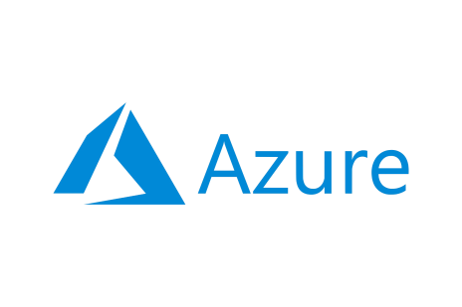

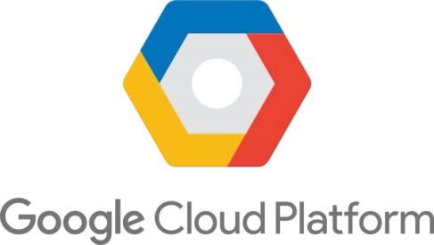
What Cloud Options We have ?
.
Top Cloud Service Provider
Below are Top 3 Cloud Services Provider
AWS
Amazon Web Services (AWS) is the world’s most comprehensive and broadly adopted cloud platform, offering over 200 fully featured services from data centers globally. Millions of customers—including the fastest-growing startups, largest enterprises, and leading government agencies—are using AWS to lower costs, become more agile, and innovate faster.
Microsoft Azure
Google Cloud Platform
The Azure cloud platform is more than 200 products and cloud services designed to help you bring new solutions to life—to solve today’s challenges and create the future. Build, run and manage applications across multiple clouds,
on-premises and at the edge, with the tools and frameworks of your choice.
Google Cloud Platform (GCP), offered by Google, is a suite of cloud computing services that runs on the same infrastructure that Google uses internally for its end-user products, such as Google Search, Gmail, file storage, and YouTube. Alongside a set of management tools, it provides a series of modular cloud services including computing, data storage, data analytics and machine learning.

Slide 10
What Skills Needed to be Cloud Job Ready?
.
Basic Cloud Knowledge Basic Cloud knowledge i.e. in depth understanding of Compute, Storage , Networking, Security is a must
Virtualization & Containerization In modern world, knowledge of OS Virtualization and Application Containerization is a must.
APIs & JSON
While working with Cloud ,often we have to integrate or work with different api, so API fundamental knowledge and know on JSON is expected
Linux & Shell Scripting Skills
Knowledge in Linux is must. Knowledge in shell scripting will make your life a lot easier while working with Cloud
Programming (Optional)
Hands-on knowledge in any programming knowledge will be very useful while developing cloud application , but it’s not mandatory, but sometime may be part of Cloud position requirement.
Database
Knowledge on popular databases such as MongoDb, MySql etc expected
Automation
Automation is one of the most significant benefits of cloud services. If applications can be programmed to make their own, correct decisions without human intervention, it can increase efficiency. Of course, cloud professionals have a role to play in facilitating this kind of automation. Specifically, they need to be well versed in the mechanics of a business's cloud architecture and the different components that interact with or depend on one other.
Cloud service platform expertise
Gaining a thorough understanding of the CSP marketplace is a good starting point. Familiarize yourself with AWS, Azure and GCP. Other companies with cloud platforms include IBM, Dell, Cisco Systems, Oracle and
Metrics and analytics
Expertise in metrics and analytics -- and understanding which metrics should be applied to specific cloud services -- will stand you in good stead. That's because these skills enable you to demonstrate the ROI of a business's cloud technology.
It is essential to differentiate between providers in terms of which may be most appropriate to house different applications or on which to run different types of workloads. You will need to be able to point out the pros and cons of each and select the best option to meet a specific need.
Cost Management
The ability to determine and monitor cost and workload estimation are valued skills. For instance, they will enable you to pinpoint if and where certain set data limits are being exceeded, which can lead to a business incurring unforeseen costs. It also enables the identification and elimination of any features that are not being used.
Each of the leading cloud platforms has its own strengths. AWS takes the lead in infrastructure. Microsoft excels in software. Google offers easy integration with other vendor products. IBM has honed artificial intelligence capability. Cisco Systems is a frontrunner in networks. And OpenStack is dominant in the software development market.

Slide 11




Good luck!
I hope you’ll use this knowledge and build awesome solutions.
If any issue contact me in Linkedin:
https://www.linkedin.com/in/harikrishna-cheruku-364b362a/
Or mail me:cheruku.harikrishna@gmail.com
Subscribe My Youtube Channel here: https://www.youtube.com/@TechWorldWithHari

